Slide 1
Stack Organization and Notations
(Lecture 22-23)

Slide 2
Introduction
Stack is also known as the Last In First Out (LIFO) list. It is the most important feature in the CPU. It saves data such that the element stored last is retrieved first. A stack is a memory unit with an address register that can count only. The register that holds the address for the stack is called a stack pointer (SP) because its value always points at the top item in the stack.). The stack pointer continually influences the address of the element that is located at the top of the stack.
It can insert an element into or delete an element from the stack. The insertion operation is known as push operation and the deletion operation is known as pop operation. In a computer stack, these operations are simulated by incrementing or decrementing the SP register.

Slide 3
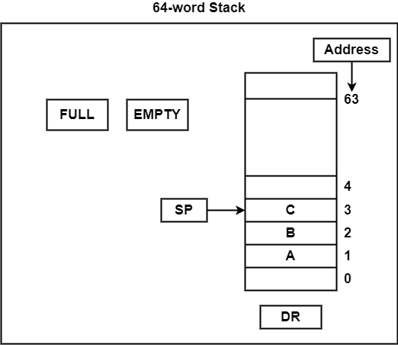
Registered Stack
Register Stack
The stack can be arranged as a set of memory words or registers. Consider a 64-word register stack arranged as displayed in the figure.
The element C is at the top of the stack and the stack pointer holds the address of C that is 3. The top element is popped from the stack through reading memory word at address 3 and decrementing the stack pointer by 1. Then, B is at the top of the stack and the SP holds the address of B that is 2. It can insert a new word, the stack is pushed by incrementing the stack pointer by 1 and inserting a word in that incremented location.

Slide 4
Continue..
The stack pointer is incremented so that it points to the address of the next-higher word. A memory write operation inserts the word from DR into the top of the stack. Note that SP holds the address of the top of the stack and that M [SP] denotes the memory word specified by the address presently available in SP. The first item stored in the stack is at address L The last item
is stored at address 0. If SP reaches 0, the stack is full of items, so FULL is set to L This condition is reached if the top item prior to the last push was in location 63 and, after incrementing SP, the last item is stored in location 0. Once an item is stored in location 0, there are no more empty registers in the stack.
If an item is written in the stack, obviously the stack cannot be empty, so EMTY is cleared to 0.
The pop operation consists of the following sequence of microoperations:
DR <--M [SP]
SP <--SP - 1
If (SP = 0) then (EMTY <--1)
FULL <--0
1. Read item from the top of stack
2. Decrement stack pointer
3. Check if stack is empty
4. Mark the stack not full

Slide 5
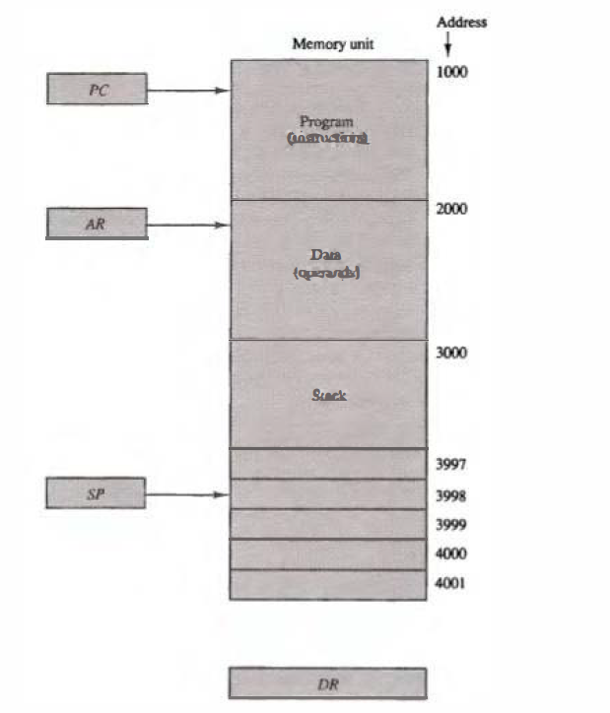
Memory Stack
Memory Stack
A stack can exist as a stand-alone unit as in last section or can be implemented in a RAM attached to a CPU. The implementation of a stack in the CPU is done by assigning a portion of memory to a stack operation and using a register as a stack pointer as shown in the figure where PC is used during the fetch phase to read an instruction. AR is used during the execute phase to read an operand. SP is used to push or pop items into or from the stack.
Suppose the initial value of SP is 4001 and the stack grows with decreasing addresses. Thus the first item stored in the stack is at address 4001 , the second item is stored at address 4000, and the last address that can be used for the stack Is 3000.

Slide 6
Continue..
Most computers do not provide hardware to check for stack overflow (full stack) or underflow (empty stack). The stack limits can be checked by using two registers: one to hold the upper limit (3000 in this case), and the other to hold the lower limit (4001 in this case). After a push operation, SP is compared with the upper-limit register and after a pop operation, SP is compared with the lower-limit register.
Advantages:-
CPU can refer to memory stack without having to specify an address, since the address is always available and automatically updated in the stack pointer.
Memory stack can potentially provide a larger storage space compared to register stack. Registers are limited in number and size, whereas memory stack can use the entire available RAM, which is significantly larger
A new item is inserted with the push operation as follows:
SP <-SP - 1
M[SP] <-DR
A new item is deleted with a pop operation as follows:
DR <-M[SP]
SP <-SP + 1

Slide 7
Reverse Polish Notation
Reverse Polish Notation
The Polish mathematician Lukasiewicz showed that arithmetic expressions can be represented in prefix notation . This representation, often referred to as Polish notation, places the operator before the operands.
The postfix notation, referred to as Reverse Polish notation (RPN), places the operator after the operands.
The following examples demonstrate the three representations:
A + B Infix notation
+ AB Prefix or Polish notation
AB + Postfix or reverse Polish notation
The reverse Polish notation is in a form suitable for stack manipulation.

Slide 8
Reverse Polish Expressions
Steps to evaluate reverse polish expression:-
1. Scan the expression from left to right. When an
operator is reached, perform the operation with the two operands found on the left side of the operator. Remove the two operands and the operator and
replace them by the number obtained from the result of the operation.
2. Continue to scan the expression and repeat the procedure for every operator encountered until there are no more operators.
e.g. AB • CD • +
For the above expression we find the operator • after A and B. We perform the operation A • B and replace A, B, and • by the product to obtain (A • B) CD • +
where (A • B) is a single quantity obtained from the product. The next operator is a • and its previous two operands are C and D, so we perform C • D and
obtain an expression with two operands and one operator: (A • B) (C • D) +
The next operator is + and the two operands to be added are the two products,
so we add the two quantities to obtain the result.
Example: Input: ["2", "1", "+", "3", "*"], Output: 9

